Slide 1
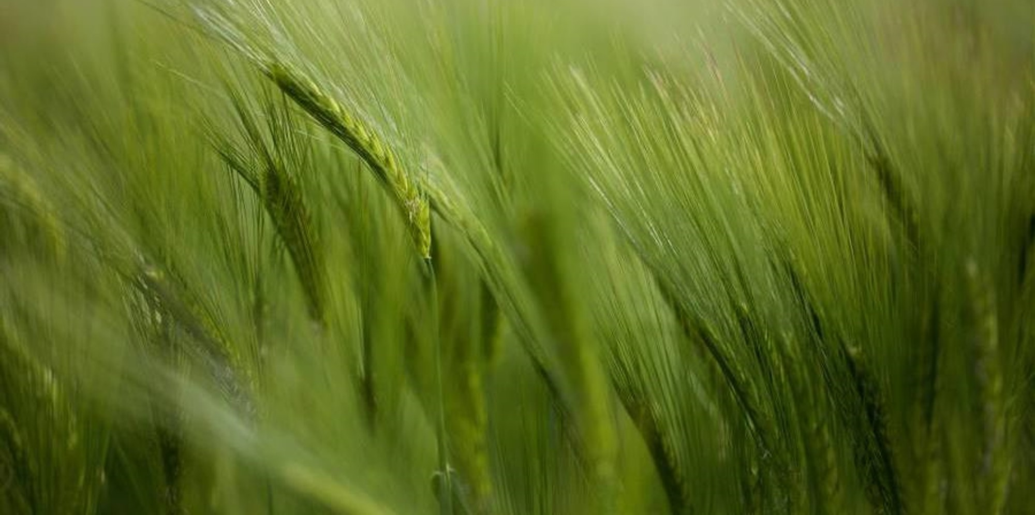


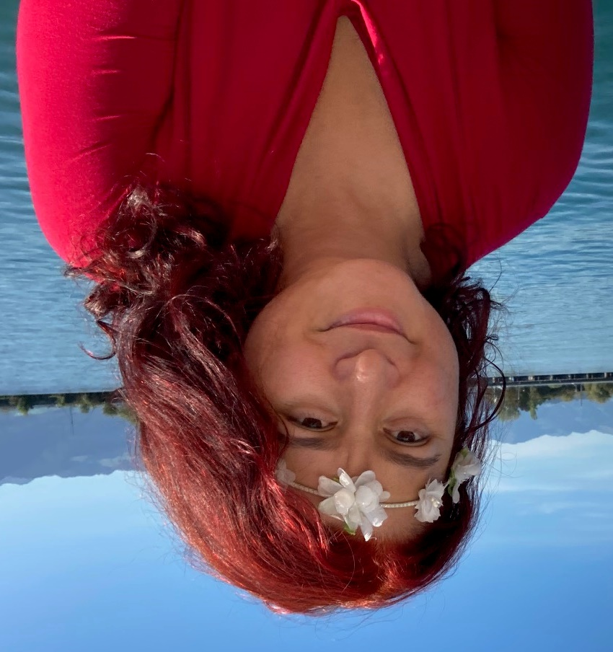



Mihaela Dudita-Kauffeld
University: Eastern Switzerland University of Applied Sciences
Study program: Environmental Engineering
Year of study: 24 years / 48 semesters
City: Rapperswil, Switzerland
Motto for life: Don’t worry, be happy
Hobbies: Gardening, biodiversity, sailing, skiing, hiking, bicycling, writing, EU-proposals ;-)
Your expectations from the summer school:
Inspire the next generation to make this world a better place
OST
Location where I live and work
Karlsruhe
31 August to 11 September 2026

